Slide 1
﻿Generating Interpretable Counterfactual Explanations By Implicit Minimisation of Epistemic and Aleatoric Uncertainties University of Oxford Artificial Intelligence and Statistics (AISTAT’21) Cited 33 times

Slide 2

Introducing Counterfactual Explanations
A different type of suggestion to change the class
A counterfactual explanation is a perturbation of the input to generate a different output y by the same algorithm.
Loan approval-
age 26y
gender F
salary $100k
residency local
credit score 700
loan amount 1 million
loan term 20y
Not approved
X_{T}
age 26y
gender F
salary $150k
residency local
credit score 700
loan amount 1 million
loan term 20y
X_{T}*

Slide 3
Problem with existing methods
Need of an auxiliary generative framework (GEN)
The GEN works as a black-box, we have limited control over the generated CFs
Might produce out of distribution CFs
GENs are good for binary classification models, bad for multi-class classification problems, increases engineering overhead, tunable params
May require multiple GENs
CF

Slide 4
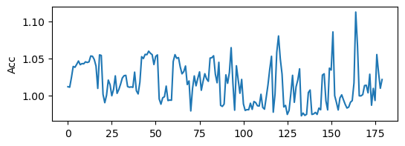
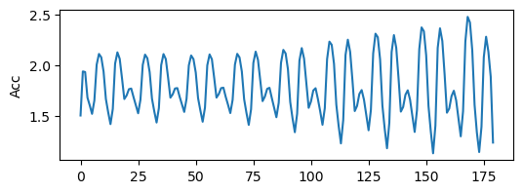
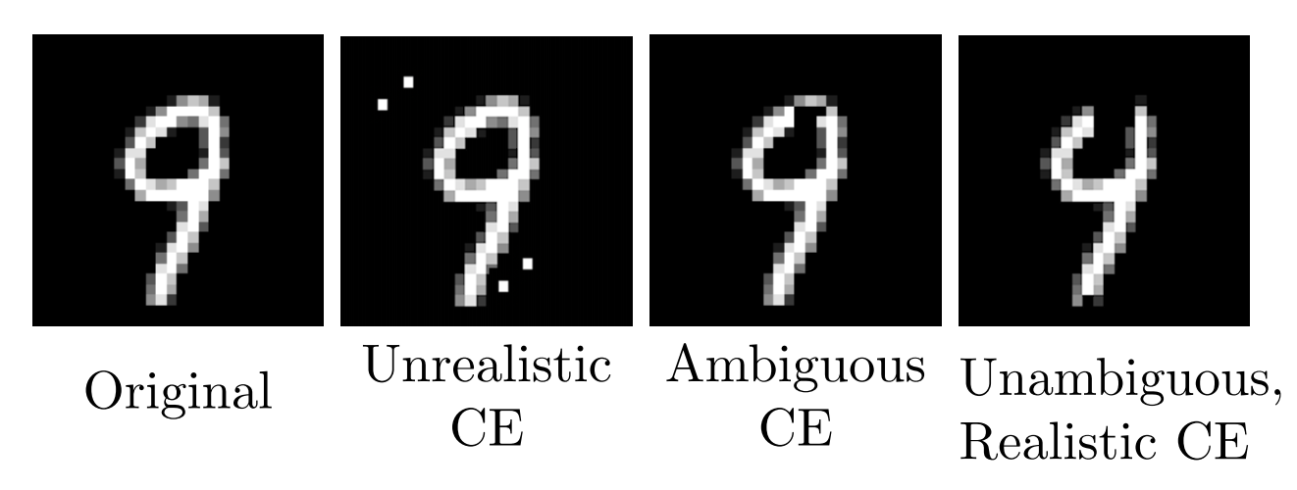
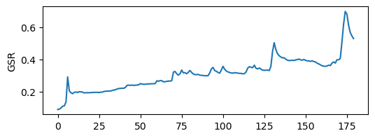
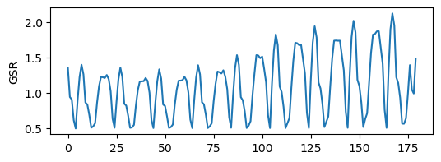
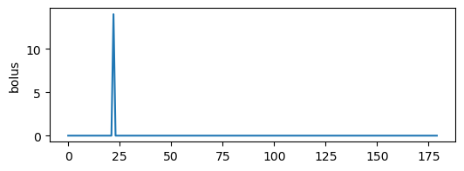
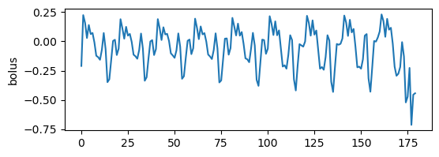
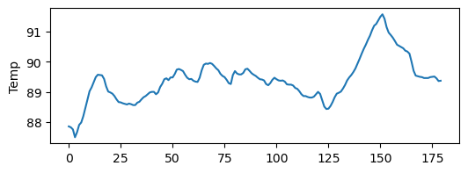
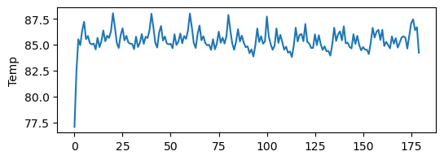
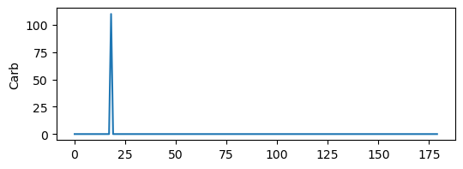
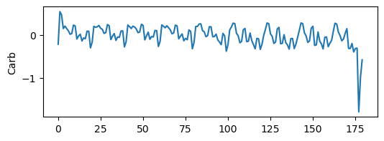
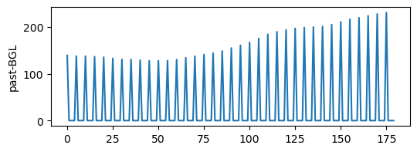
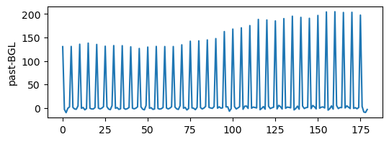
Problem with existing methods
Brings in unrealism and ambiguity
Some datasets are not good for using GENs
In
Out

Slide 5
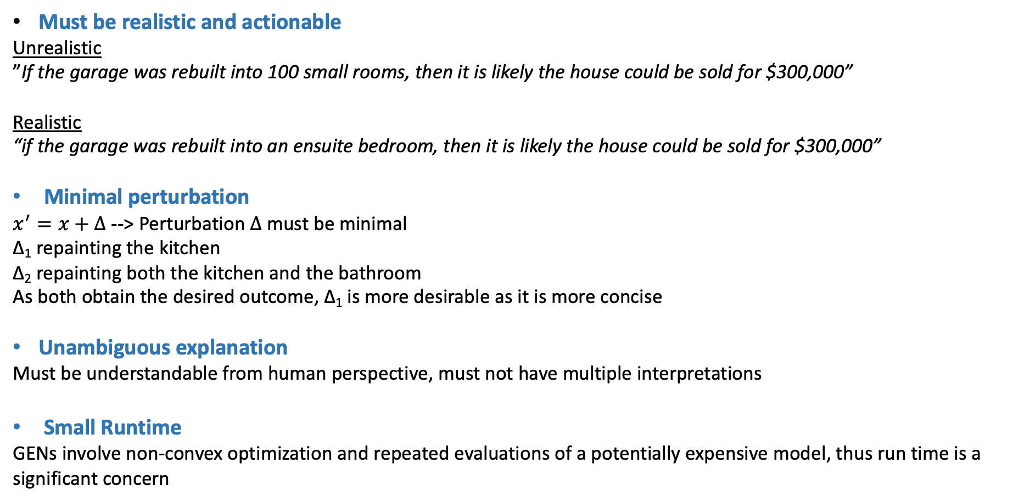
Desired properties of CFs
﻿Must be realistic and actionable
Unrealistic
”If the garage was rebuilt into 100 small rooms, then it is likely the house could be sold for $300,000”
Realistic
“if the garage was rebuilt into an ensuite bedroom, then it is likely the house could be sold for $300,000”
Minimal perturbation
﻿$x^{′}=x+Δ$ --> Perturbation $Δ$must be minimal
﻿∆₁ repainting the kitchen
∆₂ repainting both the kitchen and the bathroom
As both obtain the desired outcome, ∆₁ is more desirable as it is more concise
Unambiguous explanation
Must be understandable from human perspective, must not have multiple interpretations
Small Runtime
﻿GENs involve non-convex optimization and repeated evaluations of a potentially expensive model, thus run time is a significant concern
1

Slide 6
Reduce Epistemic and Aleatoric Uncertainty
Epistemic Uncertainty
Occurs due to lack of knowledge/information about the data
If training data is sparse, the regions with less training instances introduces Epistemic Uncertainty
Related to unrealism
Samples close to the training instances are less uncertain
Aleatoric Uncertainty
Inherent to the variability of the data
Most prominent close to the decision boundary
Related to ambiguity
CF
CF
CF

Slide 7
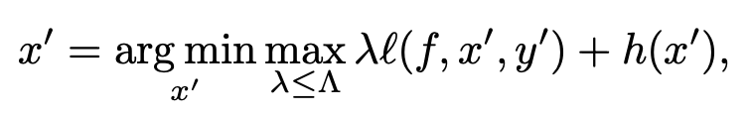
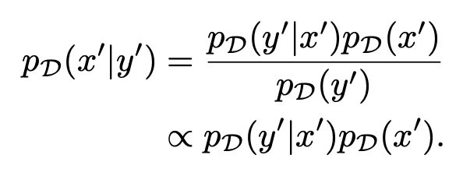


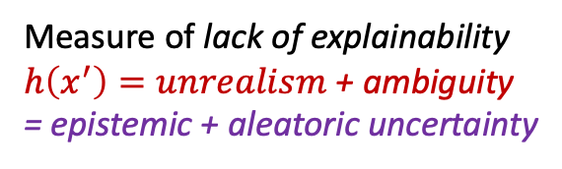
How to produce desired CFs
Measure of lack of explainability
$h\left(x^{′}\right)=unrealism$+ ambiguity
= epistemic + aleatoric uncertainty
Samples close to the training instances have less epistemic uncertainty
Where, $p_{D}(.)$ is the training data distribution
﻿Explanations which are likely under the distribution of the training data will appear familiar to the user and thus realistic.
$x^{′}$ or something close to it exist in the $y^{′}$ side

Slide 8
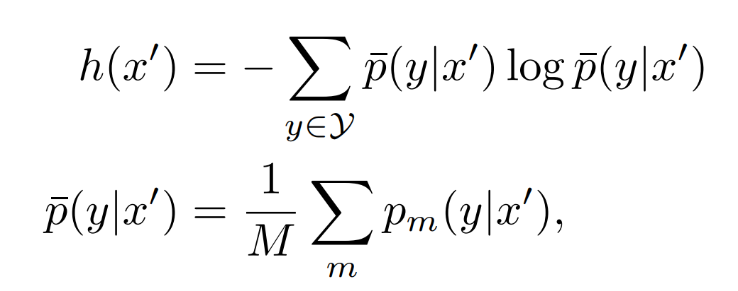



How to produce desired CFs
Samples close to the training instances have less epistemic uncertainty
One way to increase $p_{D}(y^{′}|x′)$ is using ensemble of deep neural networks
Where, $p_{D}(.)$ is the training data distribution
﻿Explanations which are likely under the distribution of the training data will appear familiar to the user and thus realistic.
$x^{′}$ or something close to it exist in the $y^{′}$ side
Reduction of Variance
Improved generalization
Combining diverse models
Robustness against outliers
Uncertainty:
entropy
Predictive entropy

Slide 9
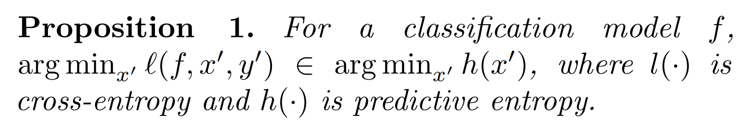
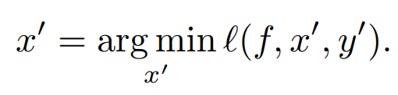

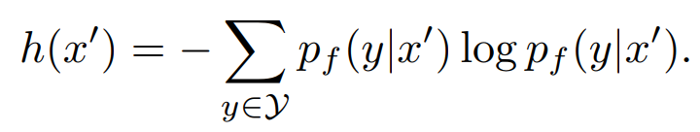
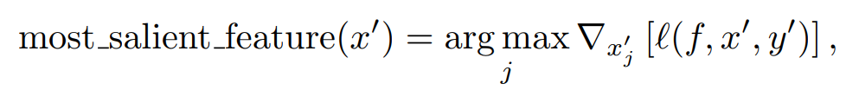
How to produce desired CFs
Uncertainty:
entropy
Predictive entropy
yields
How to make sure perturbation is minimum?
Identify the feature that impacts the most and change it
2
Perform adversarial training
Adversarial training improves uncertainty estimation, both on in-distribution and out-of-distribution inputs
﻿Augmenting the training set with adversarial examples during training ensures that the model does not focus on noise when learning features for classification.

Slide 10
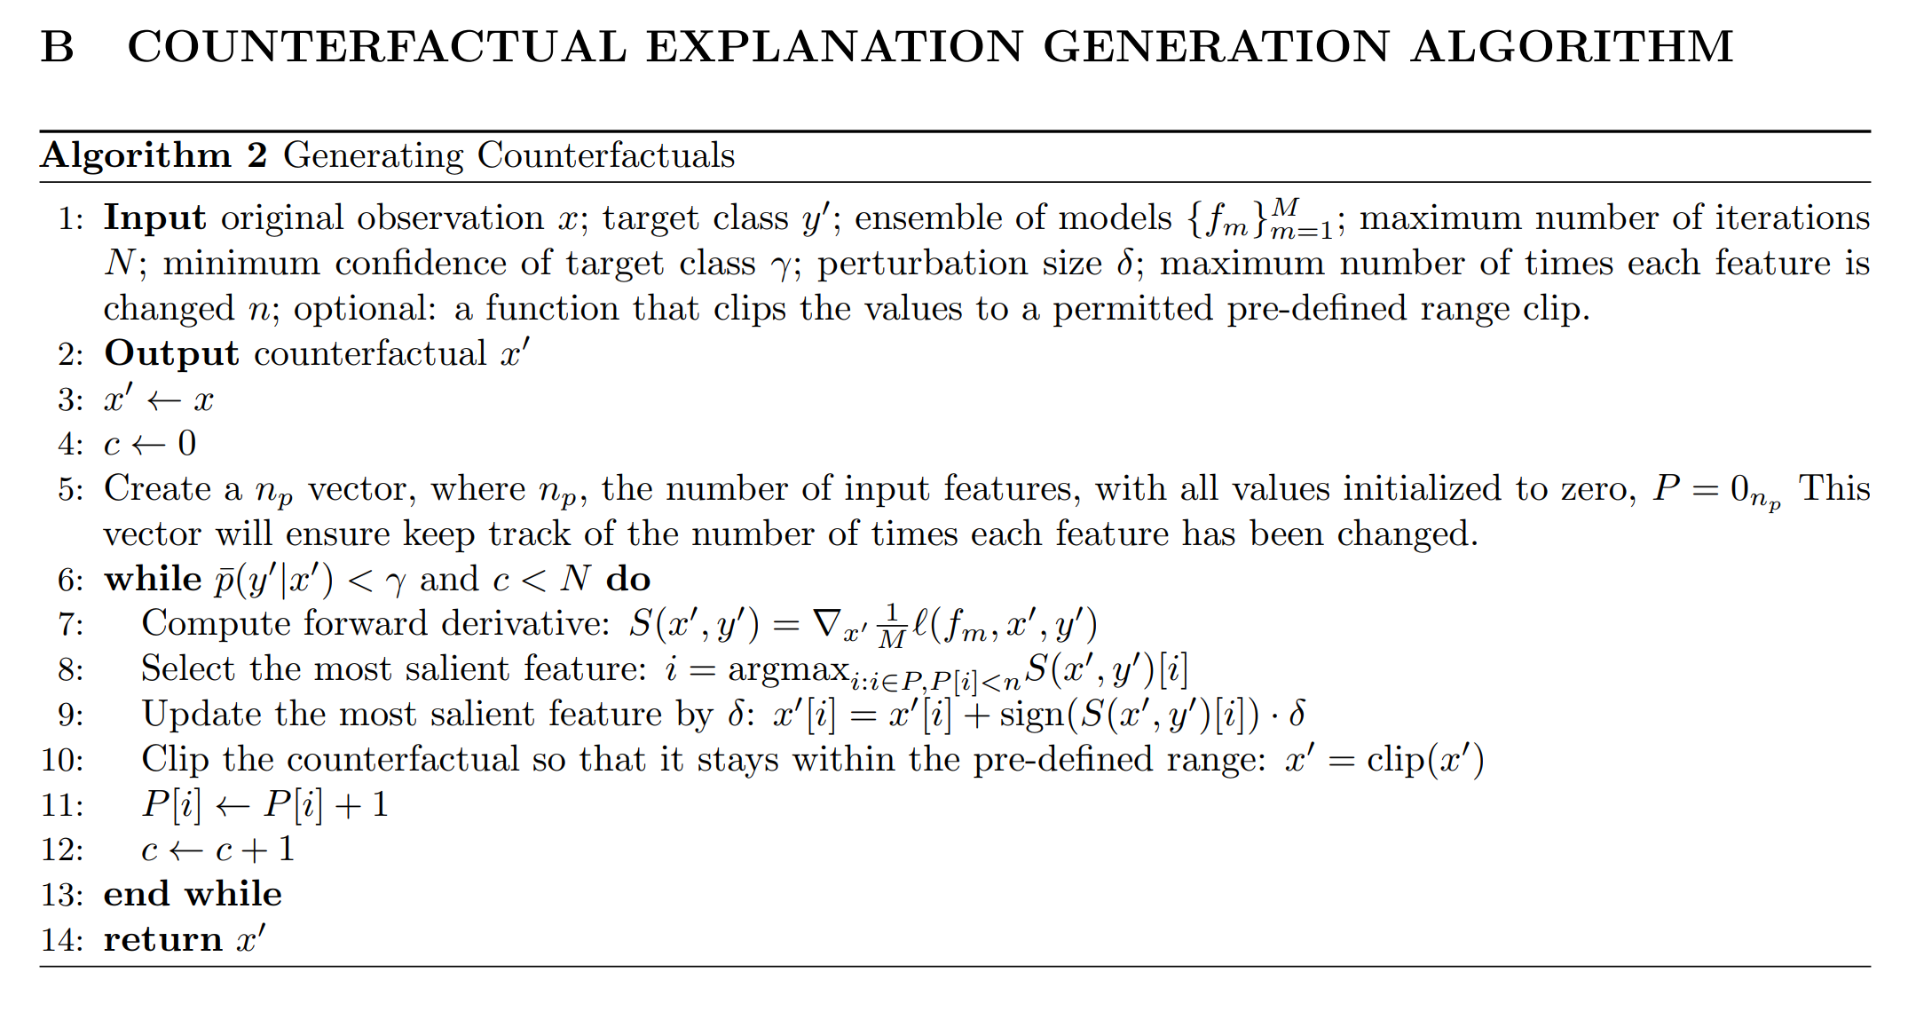
How to produce desired CFs
Iterate until minimum confidence level/max iteration is reached/
3

Slide 11
Datasets
MNIST
Grayscale images of handwritten digits (0-9)
Objective: What needs to be done to change image classification (7 to 1, 9 to 4)
Classifier is 98.5% accurate
Breast Cancer Wisconsin Diagnostic Dataset
Tabular dataset, contains various measurements of a cell sample from a tumour, binary diagnosis of benign or malignant.
Objective: Get CFs that changes malignant to benign (or vice versa)
Classifier is 96.9% accurate
Boston Housing Dataset
Another tabular dataset, contains information about housings in a suburb of Boston
Objective: What needs to be done to increase the price from below median to above
Classifier is 86.3% accurate

Slide 12
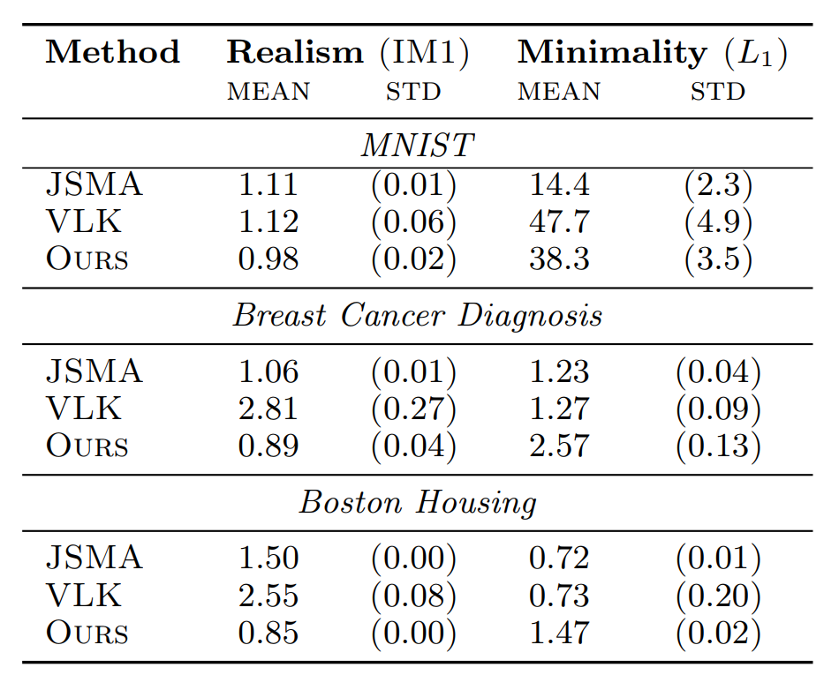
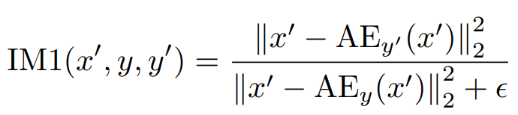


Evaluating the CFs
Comparable Methods
Van Looveren and Klaise (VLK 2019): An autoencoder (GEN) based approach for CF generation
﻿Jacobian-based Saliency Map Attack (JSMA):
Metric
IM1:
Reconstruction loss of an autoencoder trained on target class
Lower score better
$$y′$$
Reconstruction loss of an autoencoder trained on original class
$$y$$
If numerator < denominator, generated x’ is closer to the target class
If denominator < numerator, generated x’ is still closer to the source class

Slide 13
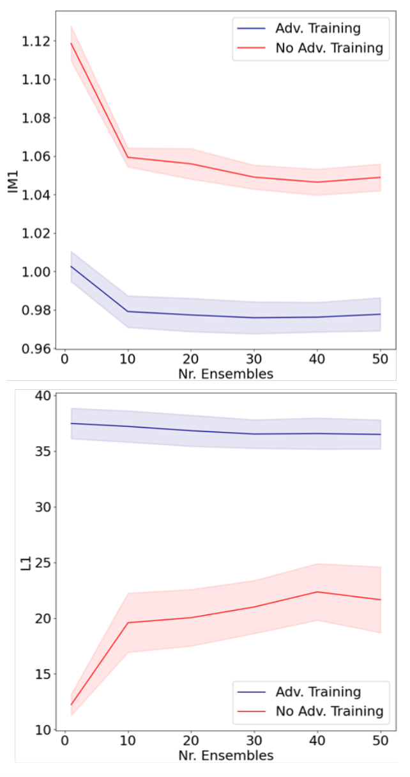
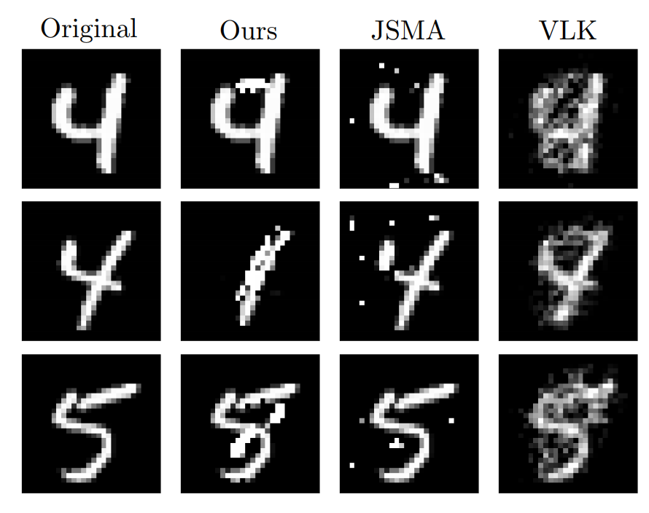
Evaluating the CFs
Ablation Study
1. Verify if adversarial training helps
2. How number of models in ensemble learning impacts the performance
Visualization

